Slide 1
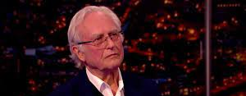
The ‘new atheism’
Faith without reason

Slide 2
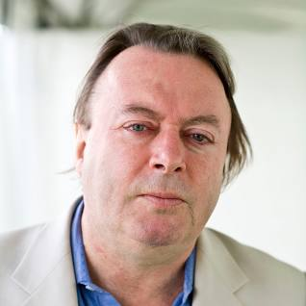
From one extreme to the other: a long history
In 2021Steve Morris wrote an article ‘Why is atheism no longer cool’? And in 2022 we see a similar theme in Sebastian Millbank’s article ‘The Strange afterlife of New Atheism’: these authors bring to our attention the fact that the ‘New atheism’ movement around in the media of the early 2000’s now seems passé – people, the media have now moved on
The ‘names’ here were of course that of the Oxford biologist Richard Dawkins, controversialists such as Sam Harris and Christopher Hitchens and, the only philosopher who liked to chip in supportively, Daniel Dennett; it seemed that the same ‘spirit’ was also in the popular books of the late physicist Stephen Hawkins – whose heroic struggle with disability rightly won admiration and, towards the end of the period, the popular television programmes by Professor Brian Cox
Of course, media hype works precisely by promoting the idea that something is ‘new’; something has just been ‘discovered’ by the ‘really clever people in the universities’; there is new progress that ordinary people need to know about
With this movement, now passed, we have another unsurprising case of ‘smoke and mirrors’ by which most popular media is characterised

Slide 3
The old swing between ‘scientism’ and ‘subjectivism’
I remember that I used to say our philosophy students at Maryvale at the time that, from what I could see, ‘ new atheism’ was a disgrace to serious philosophical atheism!! If you want serious atheism read the books of thinkers such as Bertrand Russell, A. J. Ayer, Anthony Flew, J. L. Mackie and others
An earlier generation would hear and occasionally see these thinkers on radio or TV – but of course that tended to be on ‘highbrow’ programmes
Most of the new atheists were totally ignorant of philosophy; and the most effective and perhaps entertaining ones were not academics at all – Hitchens and Harris
Millbank in his article says that what has replaced ‘new atheism’ is the ‘woke’ subjectivism that we spoke of before: the advocating, sometimes violent and intimidating of various causes which people passionately ‘feel’: we don’t want this talk of ‘scientific objectivity’ here!!
So, what we have here is another popular manifestation of the swing, the oscillation in western culture between ‘scientific objectivity as all we need’ on the one hand, to the inevitable reaction to it in ‘subjectivist feeling’ causes: this pattern we can see in the swing from 18th century enlightenment to the reaction in romanticism and in the various philosophies and cultural movements that followed, battling it out in this way
The Catholic vision of the harmony between faith and reason is lost sight of

Slide 4
Attacks on the idea of Christian faith
The authors of the two articles I mentioned usefully bring out what characterised this ‘new atheism’ wave: it was not a serious discussion of the classical philosophical arguments for God’s existence and nature
– thinkers trained in science, philosophy and theology like Oxford Alister McGrath would say how disappointing debates were with these folk, that they agreed to engage in, because of this lack of awareness of what the arguments really are and how to argue about them
The two features of the attack on religion and therefore – they assumed – on Christianity were: a) science explains everything so we don’t need religion and b) because of 9/11 we can see religions are morally dangerous
Again, these are exactly the same old themes that we see in the 18th century writing of people like Hume, Diderot and Voltaire
So, I think we can best begin at least to look at these two areas which have long been subjects discussed in Catholic apologetics

Slide 5
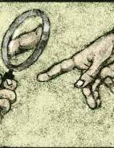
Catholic Faith and Science
A great deal of mythology has grown up in our modern media-saturated world that supports the idea that religious faith and science are deadly enemies in a war that only one of them can win, and clearly science is going to be the winner! The myths around this conflict have been growing over a couple of centuries.
There are fundamentally three areas to gain some understanding of if one is to offer a sympathetic, completely honest apologetic on this:
Science and Catholic Faith: the way the Catholic approach to Scripture involving Tradition and magisterium affects the specifically Catholic answer to the issues.
Science and Catholic Faith: the way up-to-date historical research and knowledge of the highest academic quality on the relationship between Christianity, Catholicism and science affects the discussion.
Science and Catholic Faith: the way philosophy of science affects the discussion.

Slide 6
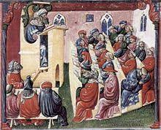
Science and Catholicism – the history
The modern revision of old historical myths
The ancient Greek philosophers – philosophy and science are tied tightly together up until a few centuries ago – and then the Roman inventors and thinkers clearly play a foundational role in the story of science.
However, two things seem to be lacking that were needed for the development of what we think of today as science. Observation and, to a certain degree, experiment were carried out by the Greeks and Romans.
But this was not with regard to the basic nature of the universe: how it is made up and what it is made up from. Rather in Aristotle, whose contribution to the rise of science was massive, there was a stress on ‘armchair’ philosophizing on how the world is basically constituted. Furthermore, Aristotle laid stress on scientific knowledge as having the certainty of mathematics and also held that the world is necessarily as it is – it could not be any other way than it is.
The scholarship shows, in fact, that the Christian worldview is the essential crucible from which modern science arises. Modern science is, without exaggeration, a child of the Catholic religion.
The rise of modern universities, a Catholic ‘invention’ was crucial
Then a Church condemnation of 1277 – yes, a condemnation! – played a vital role in the development of modern science

Slide 7
The moral history
We saw that the other prong of attack of new atheism was on morality: religion leads to immoral actions
To respond we first have to say that we need to focus on our religion: Catholicism
Here there are well-worn issues brought up against the faith: things like the crusades; the inquisition and so forth
The best apologetics a) honestly acknowledges faults and sins and b) makes use of the best up-to-date academic scholarship on a subject (written by religious and non-religious academics)
But to start, let us begin the other way around, as it were:
Our faith, we believe is founded by the Incarnate Son of God: we do not find many people, certainly not in movements like new atheism, questioning the moral power of what we read in the Gospels of the life and teaching of Christ – that has inspired and informed numerous people in moral living not only in our own culture but in many others
Indeed, what many people – new atheists included - take for granted as the basics of morality from which they judge what is a moral failure, comes precisely from this Christian heritage: it is on that basis too that we can acknowledge the sins and faults of those who came before us in the history of the Church and in ourselves – we think of the words of St Teresa of Calcutta
Why not instead go the way of the thinker Friedreich Nietzsche (1900); or of a different system of morality?
No, you are using the heritage of Christian morally to judge the failures of Christians themselves – well that is something they should welcome in some sense!

Slide 8
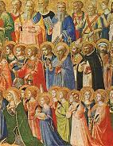
Morality and Christianity
Then one can point out that the massive evils of our modern period were perpetrated by ideologies which rejected Christianity: the French revolution; the communist regimes, the Nazi regime – as St John Paul II insisted, ‘the death of God is the death of man’
Philosophies which hold ‘the ends justifies the means’ are ready for genocide if it will help to get to the supposed ‘bright new day’ for society!
What greater moral heroes do we encounter over the last two thousand years than the numerous women and men who are the canonised saints and blessed of the Church: they set the standard of the truly moral, truly holy person
We can also think of the moral history of, for instance, the end of slavery and the elevation of the dignity of women, which as Newman long ago indicated, came with the advent of Christianity
Finally, we can look at other particular cases above, acknowledging sin and failure and the need for moral progress, while also looking at historical scholarship to show that the historical/moral picture is not at all as simple as is sometimes presented

